Slide 1

Patient-Doctor Relationships
in Canada, US, Italy, Germany and UK
This presentation is solely for the use of client personnel. No part of it may be circulated, quoted or reproduced for distribution outside of the client organization without prior written approval of ZS Associates.
Source: Research conducted by ZS in Canada, US, Italy, Germany and UK

Slide 2
Executive Summary
This document summarizes differences in patient-doctor relationships across 5 countries – US, Canada, UK, Germany and Italy. It includes findings from the analysis, comparison across countries on key dimensions and country level deep dives.
Patient involvement in Treatment DECISION
Do patients prepare for their doctor’s visit? Do they discuss about and convince doctors of their preferred treatment?
Patients in the US and Canada are more likely to be involved in their treatment, while those in UK are less likely to prepare, discuss or convince doctors of their treatment preference. Patients in Germany and Italy are likely to prepare for doctor’s visit but in Germany they are less likely to discuss treatment preferences and those in Italy are less likely to try to convince the doctors of their preferred treatment.
Confidence in doctor’s ability to UNDERSTAND/ consider patients’ treatment preference
Do patients have confidence in doctors’ abilities to understand how they feel about the treatment/ symptoms? Do they feel confident that doctors will consider their preferred treatment?
Overall, patients feel confident that their doctors understand how they feel about their condition and symptoms. However, patients in EU are slightly less confident compared to those in US and Canada that the doctors will understand/ consider their preferences when it comes to recommending a specific treatment.
OBEDIENCE TO doctor’s AUTHORITY / Reliance on DOCTOR’s recommendation
Do patients rely on doctor’s recommendation for a treatment choice? Do they obey/ follow their recommendation?
Patients in UK are most likely to rely on doctor’s recommendation for treatment options and follow their recommendation, even if their personal preference differs; those in Germany are most likely to push back if their recommendation differs from their personal preferences.
Source: Research conducted by ZS in Canada, US, Italy, Germany and UK

Slide 3
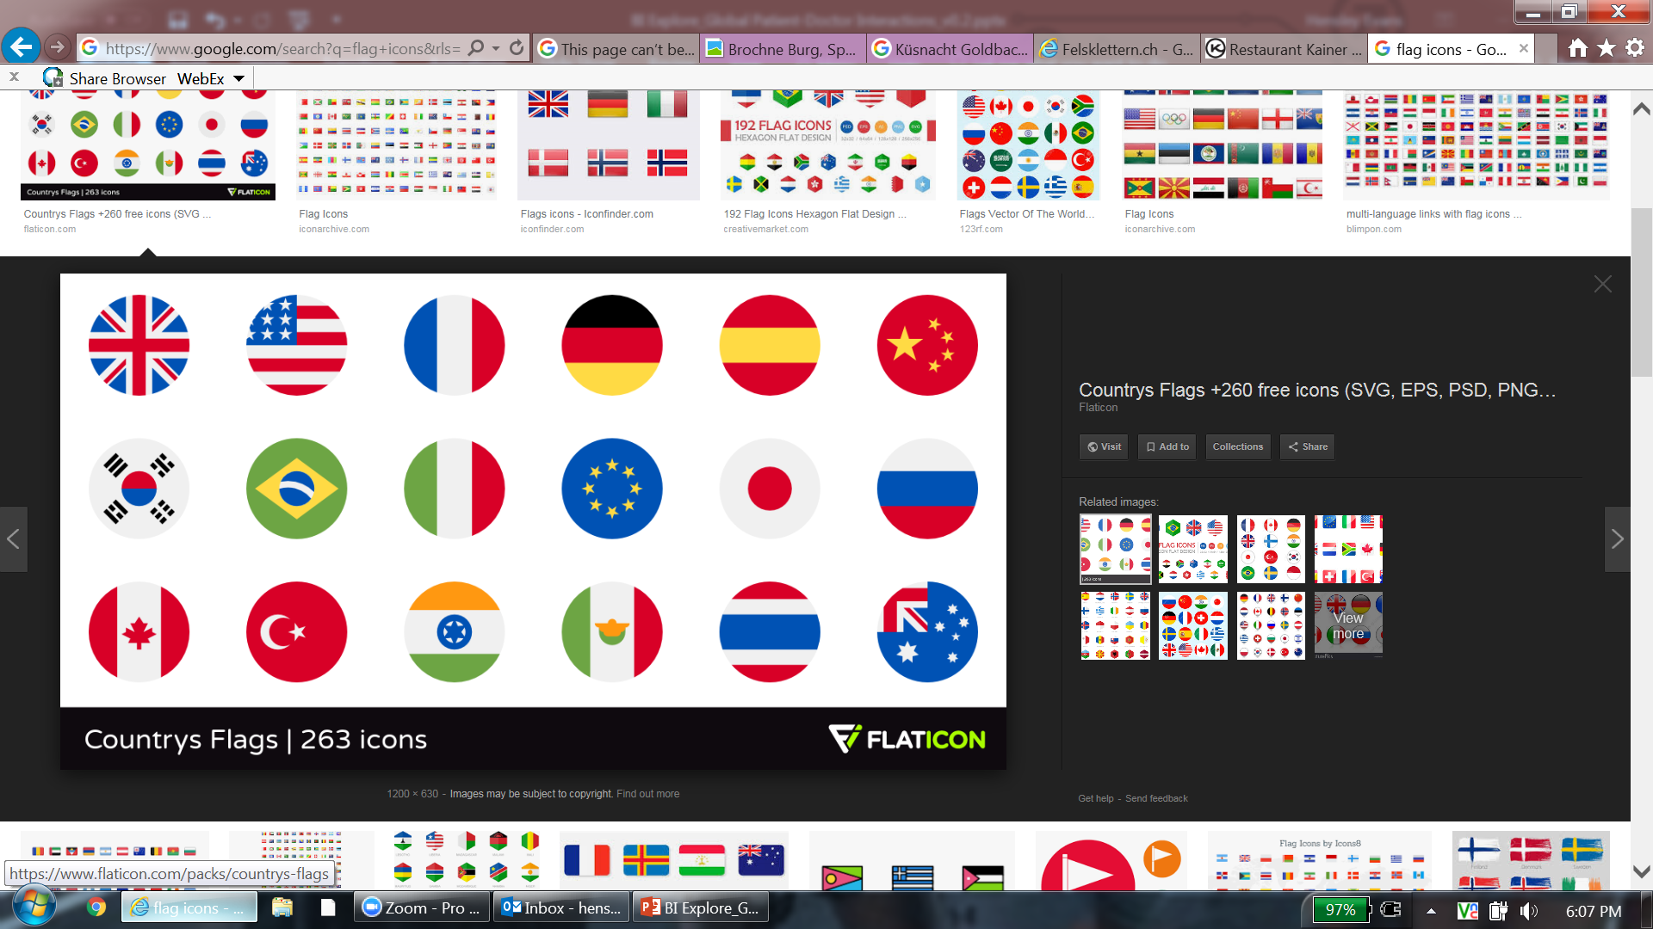
PATIENT INVOLVEMENT in Treatment
Prepare I Discuss I Convince
Belief that patients SHOULD GO to a doctor prepared with a preference for medication
Lower belief that patients should go prepared
Higher belief that patients should go prepared
Patients GO prepared with a preference for medication
Patients don’t go prepared with a preference
Patients always go prepared with a preference
Overall, most countries showed a similar pattern: they do not go to a doctor’s appointment prepared with a preferred medication as much as they believe they should. Interestingly, Italy breaks this pattern. Patients in UK are least likely to believe that people should go to a doctor’s visit prepared with a preferred medication and are also least likely to themselves prepare for their doctor’s visits. Patients in Germany and Italy are most likely to go to a doctor’s visit prepared with a preferred treatment.
Patients in UK are significantly more likely to say that patients should go with a preferred treatment when they are told that others do that or when they are asked to think about the specific reasons for why patients should go to a doctor prepared.
Source: Research conducted by ZS in Canada, US, Italy, Germany and UK

Slide 4
PATIENT INVOLVEMENT in Treatment
Prepare I Discuss I Convince
% of patients who discuss about their preferred treatment with their doctors
Low
High
Patients don’t discuss about their preferred treatment
Most of Patients discuss about their preferred treatment
Patients in the US, Canada and Italy are more likely to discuss their preferred treatment with their doctor compared to patients in Germany and the UK. Patients in the UK are also relatively less likely to visit the same general doctor (primary care physician) more than once compared to Italy and Germany where >90% of patients visit the same doctor whom they visited in last 2 years. This possibly impacts the comfort level that patients have with their doctor esp. in discussing about their treatment preferences. Additionally, the fact that patients in the UK don’t prepare ahead of their physician’s visit may lower their ability/ confidence in having an informed discussion with the doctors. In Germany, the perception that doctors may not consider patients’ treatment preferences may be a driver of their reluctance to discuss those treatment preferences with their doctor.
Source: Research conducted by ZS in Canada, US, Italy, Germany and UK

Slide 5
PATIENT INVOLVEMENT in Treatment
Prepare I Discuss I Convince
Likelihood of patients to convince the doctors of their preferred treatment
Low
High
Most patients don’t convince doctors of their preferred treatment
Most patients convince doctors of their preferred treatment
The majority of patients in the US and Canada are comfortable trying to persuade their doctors to prescribe their preferred treatment. It’s possible that the ubiquity of DTC advertising in the US (and the “bleed over” into Canadian markets) may be the key driver of patients’ willingness to ask specifically for a treatment.
Source: Research conducted by ZS in Canada, US, Italy, Germany and UK

Slide 6
PATIENT INVOLVEMENT in Treatment
Patient Involvement – Overall comparison across countries
“I know I should, and others might, but I don’t”
Agree that patients should go to their doctor prepared with a preferred treatment in mind but they themselves don’t go prepared with a preference and are less likely to ask
“Go along with the Doctor’s recommendations”
Less likely to agree that people should go to the doctor prepared to talk about medication preferences; are least likely to themselves visit with a preferred treatment in mind or ask for a specific treatment
“Buck the system – we shouldn’t but everyone does”
Don’t agree as strongly that patients should go to the doctor prepared to talk about medication preferences, but go with a preferred treatment in mind and are the most likely of any patients to ask for a specific treatment
“I do what should be done, but others don’t”
Agree that in general, patients should go to their doctors prepared to talk about medication preferences; most likely to agree that they themselves visit the doctor with a preferred treatment in mind, but less likely to believe that other patients do this
“We should have open discussions with doctors”
Agree that patients should go to their doctor prepared with a preferred treatment in mind; think a good portion of the population discusses treatment preferences with their doctors, but only a third ask about specific treatments
Source: Research conducted by ZS in Canada, US, Italy, Germany and UK

Slide 7
CONFIDENCE IN DOCTOR’S ABILITY TO UNDERSTAND/ CONSIDER PATIENTS’ TREATMENT PREFERENCE
Confidence
Confidence in doctor’s abilities to understand patients’ feelings around the condition, symptoms and treatment recommendation
Low Confidence Level
High Confidence Level
Confidence that doctors consider my (patient’s) treatment preferences
Low Confidence Level
High Confidence Level
Patients in the US are in general more confident in doctor’s abilities to understand not only their conditions and symptoms but also how they feel about the recommended treatment. Patients in Italy and Germany have relatively lower confidence that doctor will consider their treatment preference, even though they go prepared for their doctor visits. While in UK, patients are relatively more confident that the doctor will consider their preferred treatment. Despite that, they don’t discuss treatment preferences or try to persuade the doctors to prescribe their preferred treatment. This may be due to a belief that the NHS limits physician’s treatment options.
Source: Research conducted by ZS in Canada, US, Italy, Germany and UK

Slide 8
OBEDIENCE TO doctor’s AUTHORITY / Reliance on DOCTOR’s recommendation
Obedience/ Reliance
Reliance on doctor’s recommendation for a treatment
Low reliance on doctor’s recommendation for treatment
High reliance on doctor’s recommendation for treatment
Obedience to Doctor’s authority (Following doctor’s recommendation)
Low obedience to authority
High obedience to authority
Patients in Germany are least likely and those is UK are most likely to rely on doctor’s recommendation for a treatment. We could hypothesize that higher reliance on doctor’s recommendation linked to higher obedience to authority, although again, Italy bucks this trend, which relatively high reliance and relatively low obedience to authority. Reliance on physician recommendation is also inversely correlated with the likelihood that patients go to the physician’s office prepared with a specific treatment in mind.
Source: Research conducted by ZS in Canada, US, Italy, Germany and UK
Notes:
Based on the % change in likelihood to start a treatment based on doctor-provided reason vs. self-provided reason

Slide 9

Country level SUMMARY
US I Canada I UK I Germany I Italy
Patient-Doctor Relationship
Low
Patient Involvement in Treatment
High
Prepare
Discuss
Convince
Confidence that doctors understand/ consider patients’ preferences
Reliance on doctor’s recommendation for a treatment
Obedience to doctor’s authority
Overall, patients in US discuss about their treatment preference with doctors and convince the doctors if needed. They also feel confident that the doctors will understand their situation and will consider their treatment preference.
Source: Research conducted by ZS in Canada, US, Italy, Germany and UK

Slide 10
Country level SUMMARY
US I Canada I UK I Germany I Italy
Patient-Doctor Relationship
Low
Patient Involvement in Treatment
High
Prepare
Discuss
Convince
Confidence that doctors understand/ consider patients’ preferences
Reliance on doctor’s recommendation for a treatment
Obedience to doctor’s authority
Patient-doctor relationship in Canada is similar to that in USA. Patients are relatively less likely to prepare for their doctor’s visit. They also have relatively less confidence (compared to US) that the doctors will consider their treatment preference. Obedience/ reliance on the reasons provided by doctor for a treatment option is relatively higher compared to US.
Source: Research conducted by ZS in Canada, US, Italy, Germany and UK

Slide 11
Country level SUMMARY
US I Canada I UK I Germany I Italy
Patient-Doctor Relationship
Low
Patient Involvement in Treatment
High
Prepare
Discuss
Convince
Confidence that doctors understand/ consider patients’ preferences
Reliance on doctor’s recommendation for a treatment
Obedience to doctor’s authority
Patients in the UK are least involved in their treatment (prepare, discuss and convince doctors of their preferred treatment) and are most likely to rely on doctor provided reasons for a treatment and to obey the doctors authority.
Source: Research conducted by ZS in Canada, US, Italy, Germany and UK

Slide 12
Country level SUMMARY
US I Canada I UK I Germany I Italy
Patient-Doctor Relationship
Low
Patient Involvement in Treatment
High
Prepare
Discuss
Convince
Confidence that doctors understand/ consider patients’ preferences
Reliance on doctor’s recommendation for a treatment
Obedience to doctor’s authority
Patient-doctor relationship in Germany is in many ways opposite to that in the UK. They go prepared for their doctor’s visits but not always discuss their own treatment preference. However, patients in Germany are least obedient to doctor’s authority and do not completely rely on reasons provided by doctors for a treatment decision.
Source: Research conducted by ZS in Canada, US, Italy, Germany and UK

Slide 13
Country level SUMMARY
US I Canada I UK I Germany I Italy
Patient-Doctor Relationship
Low
Patient Involvement in Treatment
High
Prepare
Discuss
Convince
Confidence that doctors understand/ consider patients’ preferences
Reliance on doctor’s recommendation for a treatment
Obedience to doctor’s authority
Patients in Italy prepare for their doctor’s visit event though they rely on doctors for treatment recommendations. Italian culture is generally known for being more relaxed about authority and the same is reflected in the patient doctor relationship
Source: Research conducted by ZS in Canada, US, Italy, Germany and UK

Slide 14
For any questions or queries, please reach out to the ZS team
Hensley Evans
ZS Associates Principal Zurich (CH)
+41 79 158 78 63
hensley.evans@zs.com
Preeti Gupta
ZS Associates Consultant Zurich (CH)
+41 79 530 77 09
preeti.gupta@zs.com

